Slide 1
Cosmetic eCommerce
Non - Technical Presentation

Slide 2
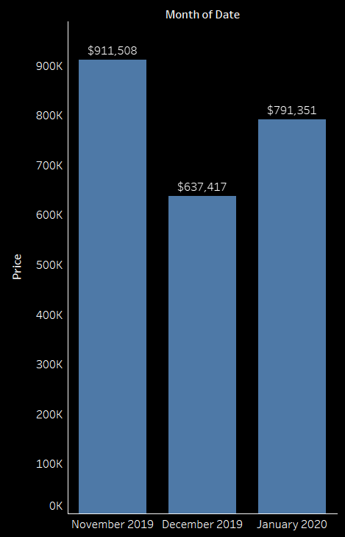
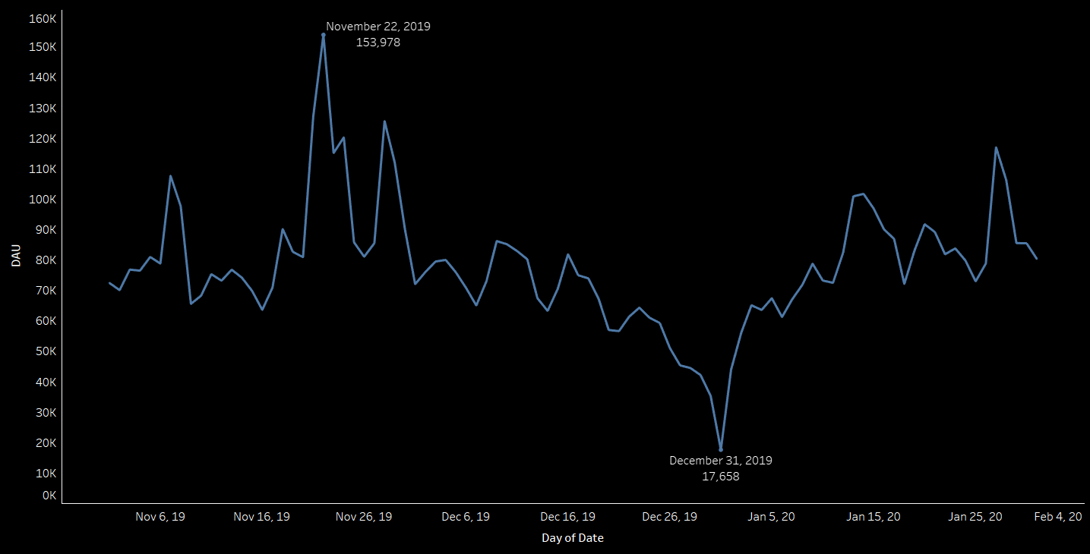
To determine the causes to an unexpected decrease of ~30% in revenue in the holiday season during December 2019, a user analysis had shown a major decrease of ~85% in the number of daily active users.
Monthly Revenue
Daily Active Users
Source: Kaggle - eCommerce Events History in Cosmetics Shop (November 2019 – January 2020)

Slide 3
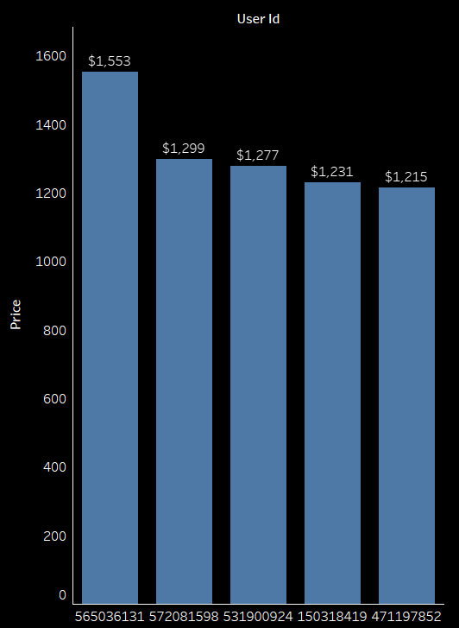
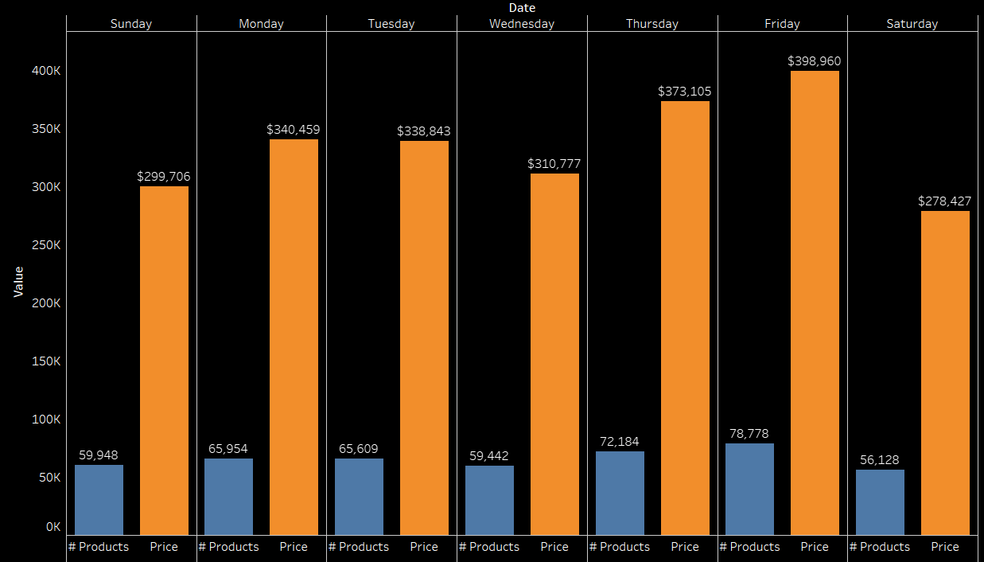
Looking closely, it seems like the top 5 users, had spent an average amount of $1315, and that the day with the most purchases was Friday.
Top 5 Users
Day of The Week Avg. Sales and Revenue
A B C D E
Source: Kaggle - eCommerce Events History in Cosmetics Shop (November 2019 – January 2020)

Slide 4
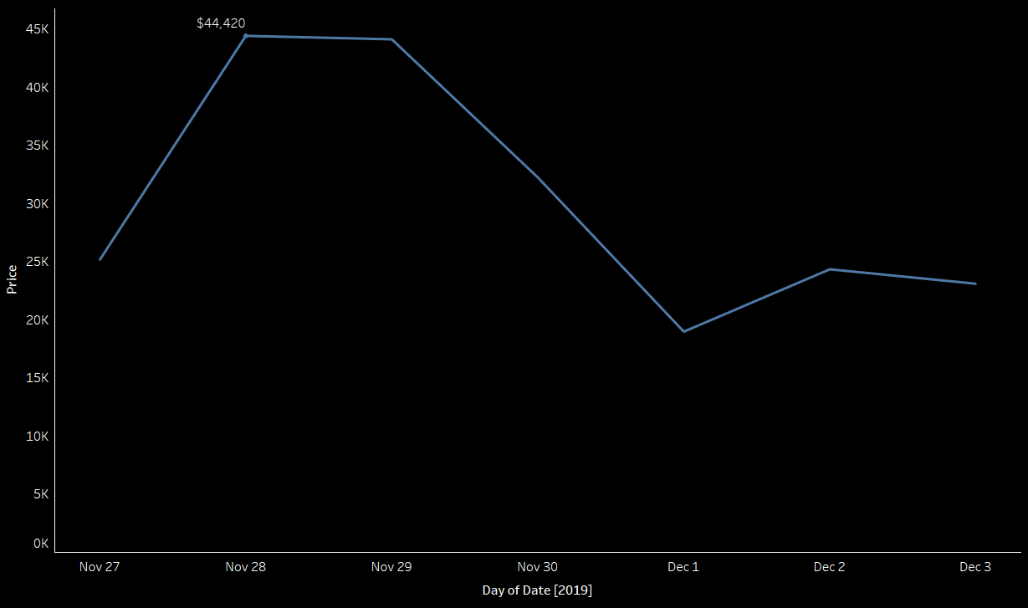
Further analysis to better understand seasonality, had shown that while sales at Thanksgiving were high, sales in Christmas had shown a slight decrease, when New Years had a major dip.
Sales and Revenue in Thanksgiving 2019
Source: Kaggle - eCommerce Events History in Cosmetics Shop (November 2019 – January 2020)

Slide 5
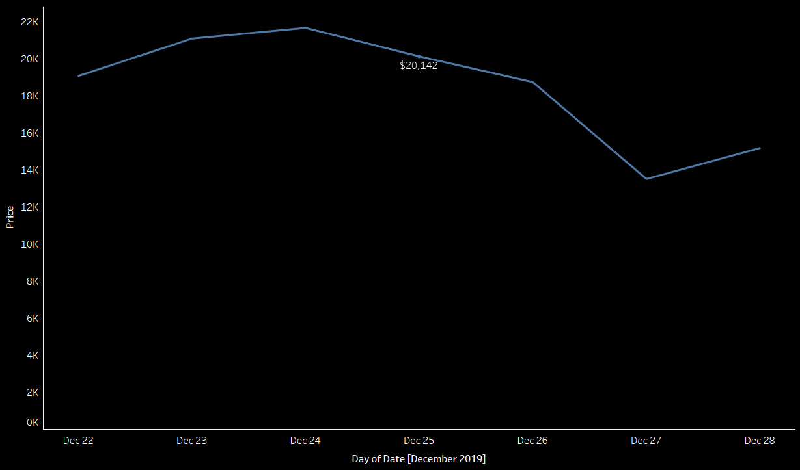
Sales and Revenue in Christmas 2019
Source: Kaggle - eCommerce Events History in Cosmetics Shop (November 2019 – January 2020)

Slide 6
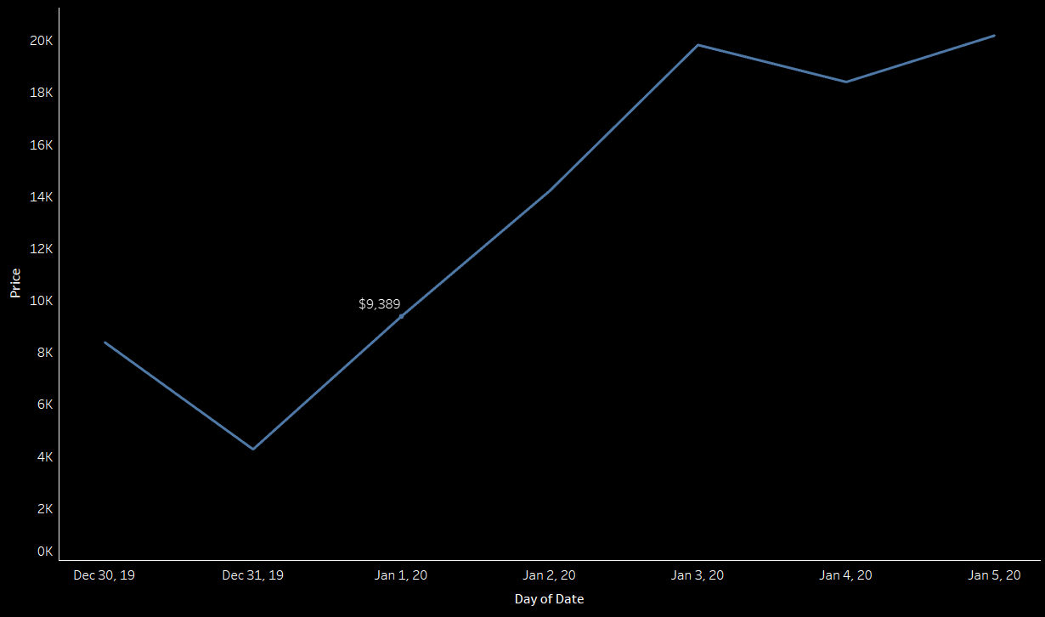
Sales and Revenue in New Years 2020
Source: Kaggle - eCommerce Events History in Cosmetics Shop (November 2019 – January 2020)

Slide 7
Thank You!

